Slide 1


Extension Methods

Slide 2
Nội dung
Special kind of Static method
Allow the addition of methods to an existing class
– Without creating a new derived type
– Without re-compiling or modifying the original type
Called The Same way regular methods are called
Define in static class

Slide 3
Nội dung
namespace StudyLinQ
{ public static class MyExtensionMethod
{
public static int SumFrom1toN(this int n)
{ int sum = 0;
for (int i = 1; i <= n; i++)
sum += i;
return sum;
}
}
}

Slide 4
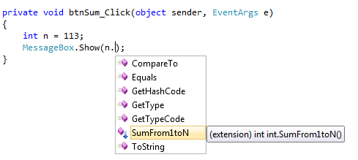
Nội dung
MessageBox.Show(n.SumFrom1toN()+"");

Slide 5
Nội dung
namespace StudyLinQ
{
public static class MyExtensionMethod
{
public static int SumFrom1toN(this int n){…}
public static string NoiChuoi(this string s1, string s2)
{
return s1 + "-" + s2;
}
}
}

Slide 6
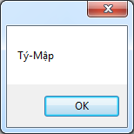
Nội dung
private void btnNoi_Click
(object sender, EventArgs e)
{
string s = "Tý";
MessageBox.Show( s.NoiChuoi("Mập"));
}

Slide 7
Nội dung
using System.Windows.Forms;
using System.Drawing;
namespace StudyLinQ
{
public static class MyExtensionMethod
{
public static int SumFrom1toN(this int n) {… }
public static string NoiChuoi(this string s1, string s2){…}
public static void ChangeColorToRed(this Button btn)
{
btn.BackColor = Color.Red;
}
}
}

Slide 8
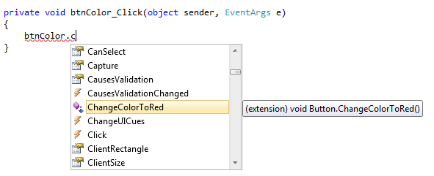
Nội dung
btnColor.ChangeColorToRed();

Slide 9


Hey! Coding is easy!
END

